Slide 1
Introduction to MySQL

Slide 2
Introduction to MySQL
MySQL is a popular, open source database.
Officially pronounced “my Ess Cue Ell” (not my sequel).
Handles very large databases; very fast performance.
Why are we using MySQL?
  Free (much cheaper than Oracle!)
  Each student can install MySQL locally.
  Easy to use Shell for creating tables, querying tables,
  Easy to use with PHP, Java, Perl, etc.

Slide 3
Connecting to MySQL
Open up a MS-DOS Prompt window
Type the following commands, press return after each command
  C:\> cd \xampp\mysql\bin
  C:\xampp\mysql\bin>mysql –u root -p
Hit return when prompted for a password

Slide 4

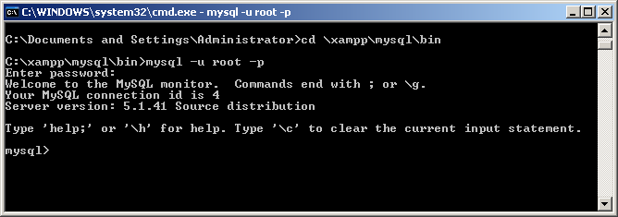
You are now in the mysql environment

Slide 5
Remember….
All commands end with a semicolon.

Slide 6
Using a Database
Using a database involves three steps:
  Creating (initializing) the database
  Creating the tables within the database
  Interacting with the tables by inserting, retrieving, modifying, or deleting data

Slide 7

Creating a Database
To get started on your own database, first check which databases currently exist.
Use the show statement to find out which databases currently exist on the server:
mysql> show databases;
2 rows in set (0.11 sec)

Slide 8
Creating a Database contd.
The MySQL server uses the first database, called mysql to keep track of users, their passwords and what theyre allowed to do. We will keep away from this database.
The second one called test is just a sample database. We will not be using this we will create our own.

Slide 9
Creating a Database (continued)
To create a new database issue the command create database.
mysql> create database videos;
Query OK, 1 row affected (0.00 sec)
Now that we have created a database, we need to tell MySQL that we want to use it.
mysql> use videos;
Database changed

Slide 10
Creating Tables
Once you have selected a database, you can view all existing tables in the database:
mysql> show tables;
    Empty set (0.00 sec)
An empty set, as you may guess, indicates that no tables have been created yet in the database.

Slide 11
Creating Tables (continued)
Let’s create a table for storing customer data
Table: “Customer”
  COLUMN DATATYPE
  CustId integer
  Name text
  Address text
  Custdate Date

Slide 12
Creating Tables (continued)
Synatx for creating a table is as follows:
mysql> create table table_name (
-> column_1_name column_1_type column_1_details,
-> column_2_name column_2_type column_2_details,
-> );

Slide 13
Creating Tables (continued)
  mysql> create table Customer (
-> custid int not null auto_increment,
-> name char(15)not null,
-> address char(20),
-> custdate date not null,
-> primary key (custid)
->) engine=InnoDB;

Slide 14
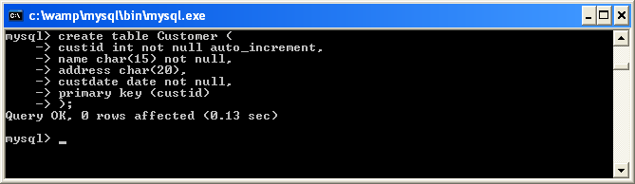

Slide 15
Creating Tables (continued)
Data types used in this database
  CHAR – a fixed length character string(1-255)
  INTEGER (int) – a whole number ranging from
    -2147683648 to 2147483647
  DATE – a date value, in “YYYY-MM-DD” format
  Refer to the handouts entitled MySQL Data Types for a complete guide.

Slide 16
Other table options:
The following options can be placed after any data type, adding other characteristics and capabilities to them.
  Primary Key. Used to differentiate one record from another. No two records can have the same primary key. This is obviously useful when it is imperative that no two records are mistaken to be the other.
  Auto_Increment. A column with this function is automatically incremented one value (previous + 1) when an insertion is made into the record. The datatype is automatically incremented when 'NULL' is inserted into the column. You may have at most one auto_increment column in a table.
  NOT NULL. Signifies that the column can never be assigned a NULL value. You can insert NULL values into tables, retrieve them from tables, and test whether or not a value is NULL. You can’t perform arithmetic on NULL values…and if you try, the result will be NULL. In the absence of either a NULL or NOT NULL, NULL is assumed.

Slide 17
Notes
In MySQL, databases correspond to directories within the data directory. (C:\wamp\mysql\data)
Tables within a database correspond to at least one file within the database directory (and possibly more, depending on the storage engine).
Consequently, the case sensitivity of the underlying operating system determines the case sensitivity of database and table names. This means database and table names are not case sensitive in Windows, and case sensitive in most varieties of Unix.
Although database and table names are not case sensitive on some platforms, you should not refer to a given database or table using different cases within the same query.

Slide 18
Identifier | Allowed characters | Max length
Database | Any character that is allowed in a directory name except / \or . Should not contain spaces. | 64
Table | Any character that is allowed in a file name, except / \or . Should not contain spaces. | 64
Column | All characters | 64
Database, table, and column names should not end with space characters.
A name may start with a number (this differs from many other database systems!).
However, a name cannot consist only of numbers.
Note that if the identifier is a restricted word or contains special characters you must
always quote it with ` when you use it.

Slide 19
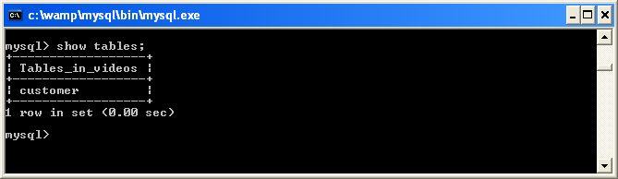
Showing Tables
To verify that the table “Customer” has been created, issue the show tables command:
  mysql> show tables;

Slide 20
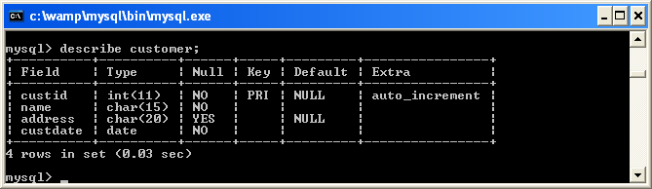
Describing Tables
To view a table structure, use the describe command:
mysql> describe Customer;

Slide 21
Loading Data into a Table
Use the insert command to enter data into a table.
Syntax for the command is as follows.
mysql> insert into table_name values
(value1, value2,....)
or
  mysql> insert into table_name set
  - > columnname1 = value1,
  > columnname2 = value2;
  or
  mysql> insert into table_name
  >(column1, column2,…..)
  > values (value1, value2,…..);

Slide 22
Loading Data into a Table contd.
  mysql> insert into Customer
  ->(name,address,custdate) values
  -> ('anne white','tralee','2007-03-03');
Take note of the format of the date….
The id is automatically added as it was set up as an auto_increment field.

Slide 23
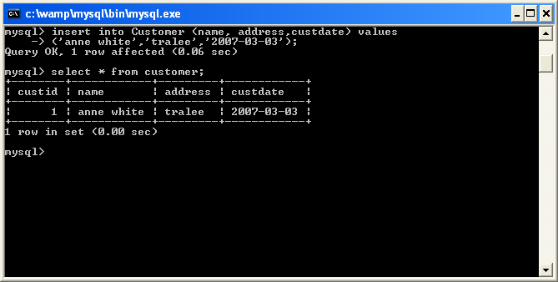
Loading Data into a Table contd.

Slide 24
You must enclose values in single quotation marks for columns whose type is character even if the data contains numbers;
If you need to enter an apostrophe into a column, you type two single quotation marks. To enter anne o’ brien you would type ‘anne o” brien’

Slide 25
The SELECT statement
The select statement is used to pull information from a table.
The general format is:
    SELECT what_to_select
    FROM which_table
    WHERE conditions_to_satisfy

Slide 26
Selecting All Data
The simplest form of select retrieves everything from a table:
  mysql> select * from Customer;
To determine how many rows you have in your table, issue the following command:
  mysql> select count(*) from Customer;

Slide 27
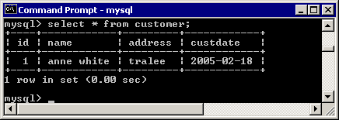
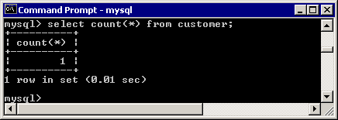

Slide 28
Selecting Specific Columns
If you don’t want to see entire rows from your table, just name the columns in which you are interested, separated by commas.
  mysql> select name from Customer;
Selects just the names from the table customer.
  mysql> select name, address from customer;
Selects just the names and addresses from the table customer

Slide 29
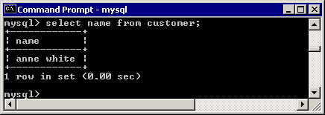
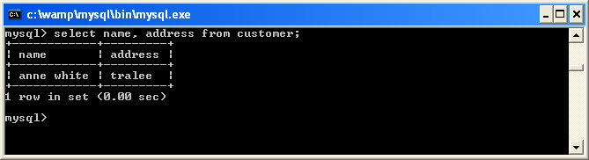

Slide 30
Selecting Specific Rows
You may select specific rows in the table that meet a certain criteria in the where clause.
For example, let’s select those rows from the ‘customer’ table where the address is “tralee”:
  mysql> select * from customer where address = “tralee”;

Slide 31
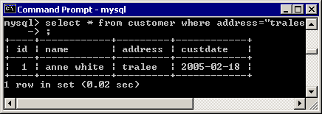

Slide 32
Selecting rows
Select all the records where the id < 3.
  mysql> select * from Customer where custid < 3;

Slide 33
Sorting Data
To sort a result, use an order by clause.
For example, to view customers sorted by name:
mysql> select * from customer order by name;
To sort in reverse order, add the desc (descending keyword)
mysql> select * from customer order by name desc;

Slide 34
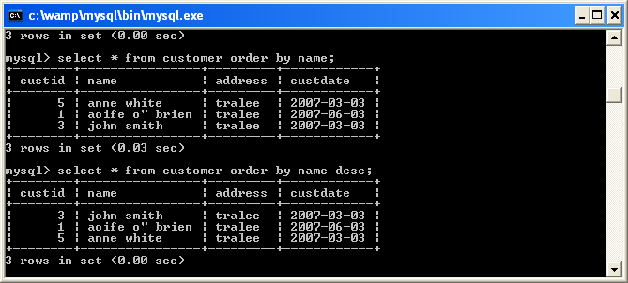

Slide 35
Pattern Matching
MySQL provides:
  standard SQL pattern matching; and
  regular expression pattern matching, similar to those used by Unix utilities such as vi, grep and sed.
SQL Pattern matching:
  To perform pattern matching, Use the like or not like comparison operators
  By default, patterns are case insensitive.
Special Characters:
  _ Used to match any single character.
  % Used to match an arbitrary number of characters.

Slide 36
Pattern Matching contd.
  mysql> select * from customer where name like ‘%nn%’ ;
The like keyword tells MySQL that the named column must match the given pattern.
In this case the pattern we have used is “%nn%”. The % symbol indicates that the letters “nn” may be preceeded and/or followed by any string or text.

Slide 37
Pattern Matching contd.
  mysql> select * from customer where name like ‘%nn%’ and custdate < ‘2007-06-03’;
As before except an additional constraint is added to the query, the date must also be less than 2007-06-03

Slide 38
Modifying Stored Data
Having entered your data into a database table, you might want to change it using the update command.
The general form of the UPDATE command is:
  mysql> UPDATE table_name SET
  -> column_name = new_value
  -> WHERE conditions;
For example, let’s change the address for the person called anne white:
  mysql> update customer set address = ‘cork’ where name = ‘anne white’;

Slide 39
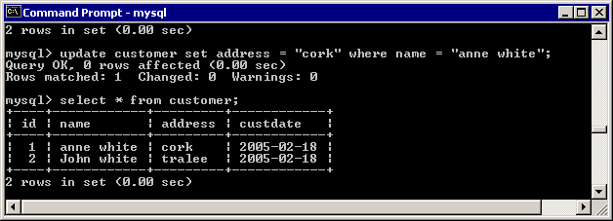
mysql> update customer set name = ‘no name’
where name like ‘%nn%’ and
custdate < ‘2007-06-03’;
What does the above line do ?

Slide 40
Altering the structure of the Table
Alter table queries may be used to change the definition of a table without losing any of the information in the table.
Synax for the comamnd is:
mysql> alter table table_name action [, action…]
Add a new column to the table customer called Amount and is of type float
mysql> alter table customer add column Amount float;

Slide 41
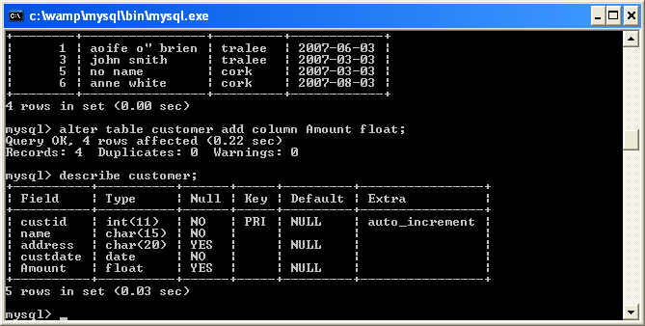

Slide 42
Altering the structure of the Table contd.
  mysql> alter table xx add primary key (number);
Changes the column called number to be the primary key. If a primary key already exists for the table an error occurs (which is why we cannot do it to the Customer table). Also the column in question i.e. number has to be set up as not null.

Slide 43
Altering the structure of the Table contd.
  mysql> alter table customer drop column amount;
Delete the column amount from the table customer.
  mysql> alter table customer change column address custaddress varchar(35) not null;
This query can also be used to rename a column, but you have to redefine the column type etc. you cannot just specify the new name.

Slide 44
Working with Multiple Tables
The queries we’ve written so far have pulled data from a single table.
Now we get to the interesting part. The power of a relational DBMS lies in its ability to relate one thing to another because that allows one to combine information from multiple tables to answer questions that can’t be answered from individual tables alone.
When you select information from multiple tables, you’re performing an operation called a ‘join’. This is because you are producing a result by joining the information from one table to the information in another table. This is done by matching up common values in the tables.

Slide 45
Choose your engine
The number of database engines available to you depends on how your installation of MySQL was compiled.
To add a new engine, MySQL must be recompiled.
By default, MySQL supports the following database engines: ISAM, MyISAM, InnoDB, Memory, CVS, Merge, Archive to name but a few.
The version of MYSQL that we have in the labs is version 5.5.x. Its default engine is Innodb unless it has been modified.
mysql>SHOW ENGINES\G
Refer to the link entitled database engines.

Slide 46
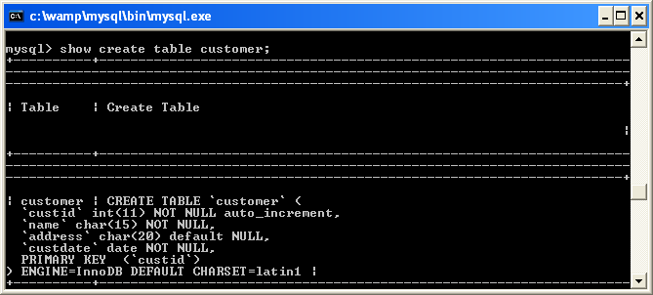
What type is my table?
mysql> show table status;
or
mysql> show create table customer;

Slide 47
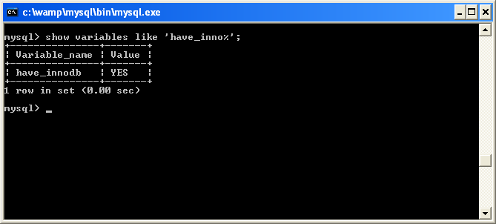
Can we switch between engines?
mysql> show variables like 'have_inno%';
If the output from the query shows a value of ‘no’ the handler is unavailable, i.e. the InnoDB engine is not available.
  mysql> alter table customer type=myisam;
to switch to the myisam engine.

Slide 48
Joining Tables
Try creating a video table that has a
  videoid
  name
  rating
  rented enum(‘N’, ‘n’,’Y’,’y’)
Add 4 valid records to the table.
Then create a query that brings back the id of all the videos rented.

Slide 49
The ENUM Type
An ENUM is a string object whose value normally is chosen from a list of allowed values that are enumerated explicitly in the column specification at table creation time.
The value may also be the empty string ("") or NULL under certain circumstances:
  If you insert an invalid value into an ENUM (that is, a string not present in the list of allowed values), the empty string is inserted instead as a special error value. This string can be distinguished from a 'normal' empty string by the fact that this string has the numerical value 0.
  If an ENUM is declared NULL, NULL is also a legal value for the column, and the default value is NULL. If an ENUM is declared NOT NULL, the default value is the first element of the list of allowed values.

Slide 50
Foreign Keys and Referential Integrity
A foreign key allows you to declare that a key in one table is related to a key in another table, and referential integrity allows you to place constraints on what may be done to the table containing the foreign key.
Referential Integrity (RI) is a key concept that describes the Foreign Key (FK) to Primary Key (PK) relationships between tables. Foreign keys are those columns that identify a single row in a related table.
RI states that any columns designated as FKs must either contain values that exist as a PK in the related table or be NULL.

Slide 51
Four types of updates must be monitored to prevent violation of referential integrity :
Insertion of tuple with FK
Change in FK value to a value that does not exist as a PK value
Deletion of tuple with a PK value that exists as a value of one or more FK’s
Change of PK value if original PK is a FK value.

Slide 52
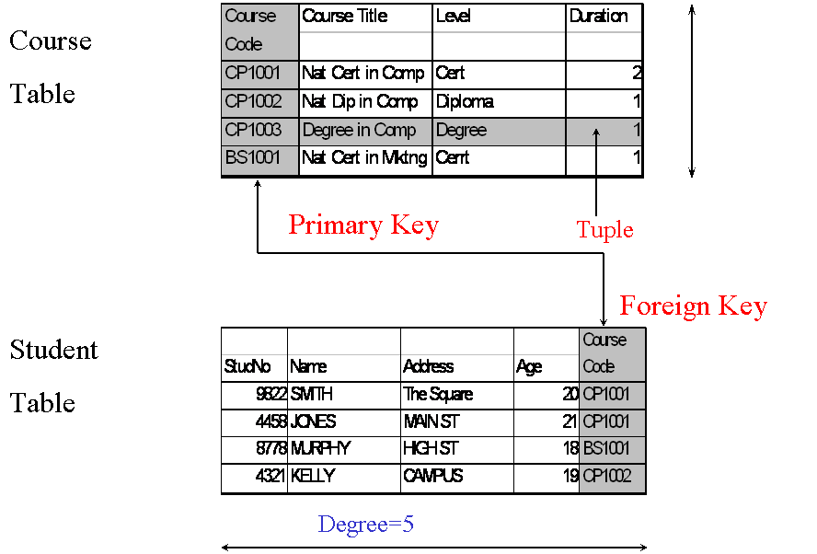

Slide 53
Defining Foreign Keys in MySQL
Strictly speaking, for a field to be a foreign key, it needs to be defined as such in the database definition.
In order to create a foreign key, you need the following:
  Both tables need to be InnoDB tables.
  To use the syntax FOREIGN KEY(fk_fieldname) REFERENCES table_name (fieldname)

Slide 54
CREATE TABLE customer_sales
(
transaction_id INT NOT NULL,
amount INT,
customer_id INT NOT NULL,
PRIMARY KEY(transaction_id),
FOREIGN KEY (customer_id) REFERENCES customer (custid)) engine=InnoDB;

Slide 55
Joining Tables
Create a new table called Rental that contains the following fields
  Rentalid
  custid (will relate to the custid in customer table)
  Videoid (will relate to the videoid in video table)
  DateRented
  DueDate
Add 4 records to the table

Slide 56
Remember: When combining (joining) information from multiple tables, you need to specify how records in one table can be matched to records in the other.
Select the dates they were rented and the name of the person who has rented them.

Slide 57
Deleting Stored Data
The deletion of entries in SQL is dangerously easy.
Here is the command syntax:
  mysql> delete from table_name
    -> where conditions;
  mysql> delete from customer where name = ‘anne white’;
Check the record has been deleted.
  mysql> select * from Customer where name = ‘anne white’;

Slide 58
Deleting Stored Data contd.
One thing to note is that the where clause is actually optional. You should be very careful, however, if you leave it off, as the delete command will then apply to all entries in our table. The command will empty the customer table in one fell swoop:
  mysql> delete from Customer;
Ooops….sorry, no recycle bin!

Slide 59
Deleting Tables
To delete an entire table, use the drop table command.
  mysql> drop table Customer;

Slide 60
Cancelling a Command
If you decide that you do not want to execute a command that you are in the process of issuing, cancel it by typing “\c” or “clear;”
(Note that all text commands must be first on line and end with ';‘)
  mysql> select * from user \c
  mysql> clear;

Slide 61
Quit
Finally at any time you want to quit out of the MySQL client program just type quit or exit. This is the only command that does not need a semicolon.
    mysql> quit

Slide 62
To back up your database and data
MySQL databases are simply files stored on your web server, therefore the whole backup and restore process is extremely easy.
There are different ways to perform a MySQL backup. However, no matter which application, control panel tool, or SSH script you use, the dump will work.
A MySQL dump is a universal backup solution. It is a bit slower than a raw backup, since it covers all SQL queries required to re-create the tables of the database, as well as all insert queries required to place the information back into the database's tables.
Using a MySQL dump you can easily migrate (all the contents of) your website from one hosting provider to another.
The MySQL dump backup solution is suitable for backing up whole databases, as well as a single database table.
Note: You cannot physically copy Innodb tables

Slide 63
To back up your database and data
To back up your database you can use a command called mysqldump. To do this:
Exit out of mysql
From the DOS prompt go to the following directory: C:\xampp\mysql\bin>
Type the following:
  C:\xampp\mysql\bin>mysqldump.exe -u root -p videos > \videos.sql
When prompted for a password just hit return.
Always check to make sure the sql file has been created correctly.

Slide 64
To restore the backup
Open the sql environment
From there create the database again
  mysql> create database videos;
  mysql> use videos;
Open a DOS prompt and type
  C:\xampp\mysql\bin>mysql.exe -u root -p videos < \videos.sql
Hit return when prompted for the password
The database should now be restored

